Slide 1
AMAZON SALES TRENDS
Aditya Prakash​

Slide 2
AGENDA
Introduction​
Primary goals
Architecture
​Areas of growth
​Summary​

Slide 3
Introduction
In the fast-paced realm of e-commerce, Amazon has emerged as a formidable force, redefining the way we shop and sell online. The trajectory of Amazon's sales trends provides a captivating window into the ever-evolving dynamics of consumer preferences, market competition, and technological advancements. In this brief exploration, we'll peel back the layers of Amazon's sales trends, offering a glimpse into the driving forces behind its growth, the influence of external factors, and the strategies that propel sellers to success in this dynamic digital marketplace.

Slide 4
PRIMARY GOALS
Creating Amazon Sales Trend

Slide 5
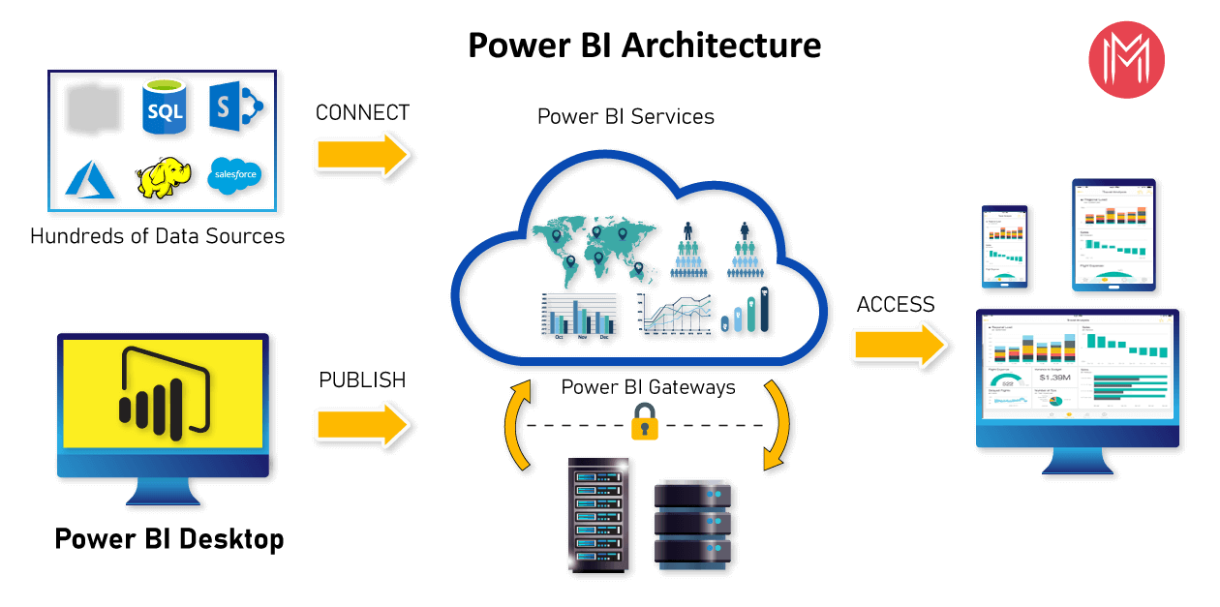
ARCHITECTURE

Slide 6
SALES TRENDS

Slide 7
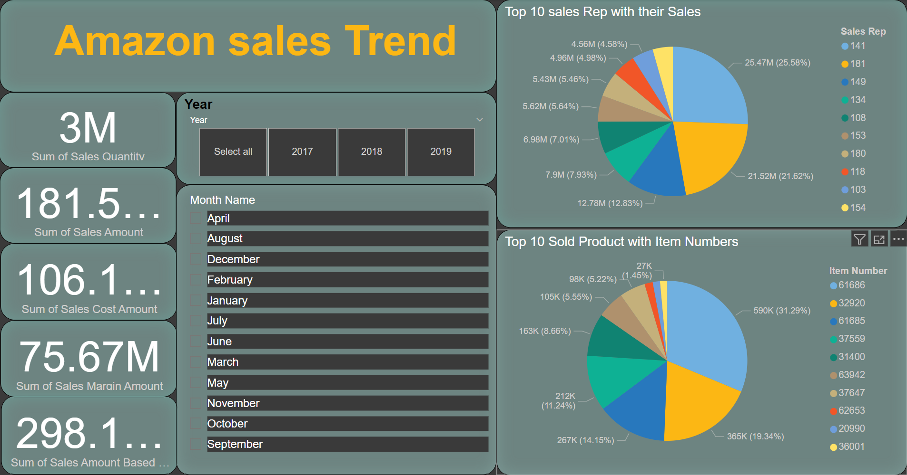
TOP SELLING PRODUCTS

Slide 8
SUMMARY
Amazon's sales trends encapsulate the dynamic shifts and patterns in consumer behavior, market competition, and technological advancements within the realm of e-commerce. This summary delves into the essence of these trends, highlighting key factors such as evolving consumer preferences, competitive strategies, and external influences that shape Amazon's sales trajectory. Understanding these trends offers valuable insights for sellers aiming to optimize their strategies, adapt to seasonal fluctuations, and navigate the ever-changing landscape of one of the world's largest online marketplaces.

Slide 9
THANK YOU
Aditya Prakash​
adityaprakash2lry@gmail.com

